Slide 1

Javascript Basics (variables, comments)
by
M NAVEENKUMAR
Assistant Professor
Department of Computer Science and Engineering
SRI RAMACHANDRA ENGINEERING AND TECHNOLOGY
Sri Ramachandra Institute of Higher Education and Research

Slide 2
Javascript Variables

Slide 3
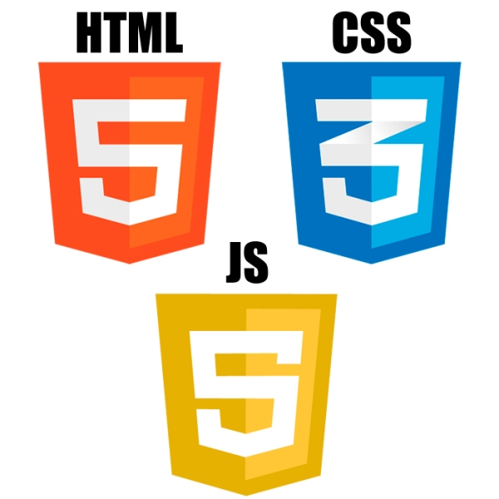

Three core web technologies
Structure
Style
Behaviour
(Functionality)

Slide 4
Javascript
Used to make web pages interactive
Insert dynamic text into HTML (ex: user name)
React to events (ex: page load user click)
perform calculations on user's computer (ex: form validation)

Slide 5
Variables
var message = “hai” ;
keyword
Variable_name
value
A variable is a name associated with a piece of data
Variable = information container
In Js, Variable definition starts with ‘var’
Js is dynamically typed language
Js is case sensitive

Slide 6
Variables Examples
var x = 10;
var y = 17;
var color = “red”;
var name = “Katie”;

Slide 7
Embed a script
file1.html
<!DOCTYPE html>
<html>
<head>
<script>
javascript code;
</script>
</head>
<body>
<script>
javascript code;
</script>
</body>
</html>
<script>
javascript code;
</script>

Slide 8
Embed a script
myfile.html
<!DOCTYPE html>
<html>
<head>
<script src=“myscript.js”>
</script>
</head>
<body>
<script src=“myscript.js”>
</script>
</body>
</html>
myscript.js
javascript code

Slide 9
Comments in Javascript
<script>
/* this is an example
of javascript
*/
var num =10; // variable declaration
alert(num);
</script>
Single Line
Multi Line

Slide 10
Different ways of declaring a variable
example
<script>
{
let msg1 = "hai"; // block scoped
var msg2 = "hello"; // function scoped
const msg3 = "welcome"; //block scoped
}
alert(msg1); //error:msg1 is not defined
alert(msg2); // no error
alert(msg3); // error:msg3 is not defined
</script>
declaration
let msg1;
var msg2;
const msg3;

Slide 11
Different ways of declaring a variable
example
<script>
{
let msg1 = "hai";
var msg2 = "hello";
const msg3 = "welcome";
msg1 = " hi " ;
msg2 = " hai " ;
msg3 = " hello" ; //error: Assignment to const
}
</script>
const variables cannot be updated

Slide 12
Print the variable to console
example
console.log(varname)
<script>
{
let msg1 = "hai";
console.log(msg1);
}
</script>

Slide 13
Challenge 1
Declare a variable myVar and assign value 10.
Print this variable to console
Note: variable myVar will not be reassigned in the future.

Slide 14
Answer
Challenge 1
<script>
{
const myVar = 10;
console.log(myVar);
}
</script>

